Slide 1
Problem Overview
Multi-stage system: Security → Immigration → Exit
Objective: Analyse throughput, congestion, and bottlenecks
Key challenge:
Shared counters + First Come First Served (FCFS) queues
Probabilistic secondary inspections
Variable demand scenarios (Default / Holiday / High Risk)
Goal: Identify system bottlenecks and evaluate performance under stress conditions

Slide 2
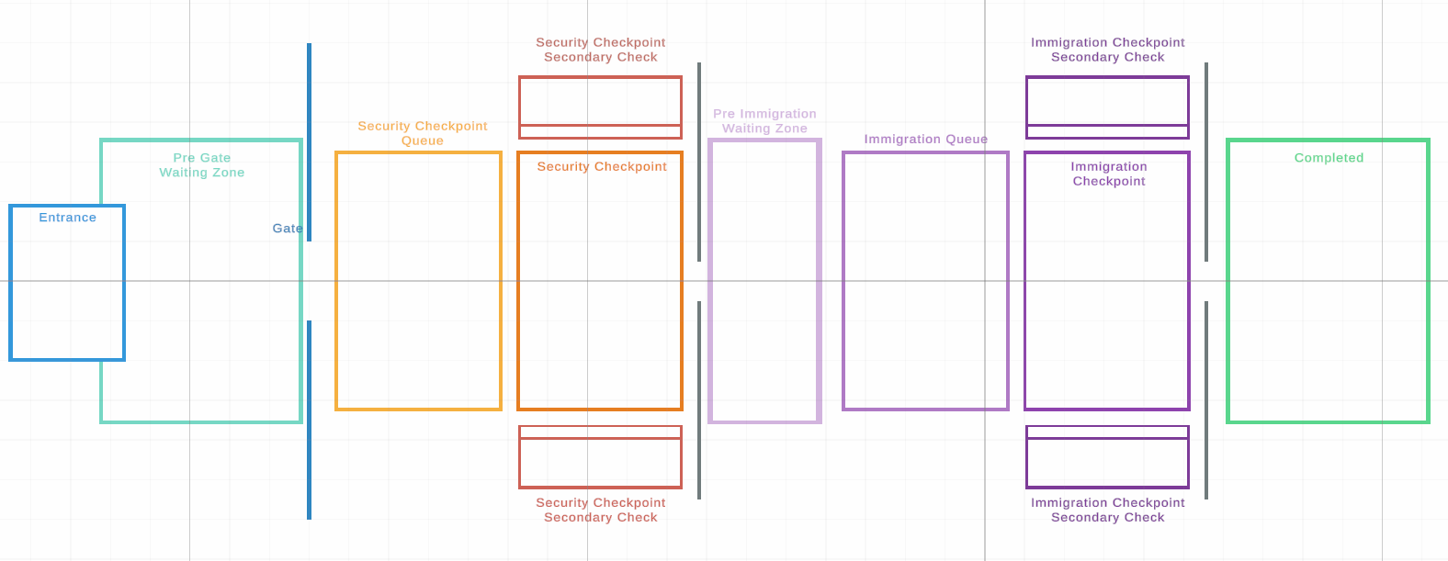
Simulation design & Assumptions
Frame-based, manager-driven simulation
Agent-based flow through discrete processing stages
Key assumptions:
Strict forward-only movement (no backtracking)
FCFS queues for primary stages
Shared service counters per checkpoint
Secondary inspections triggered probabilistically
No queue abandonment or impatience
System structure:
Ordered queues → Security & Immigration
Secondary queues → inspection areas
Push-based assignment to available counters

Slide 3
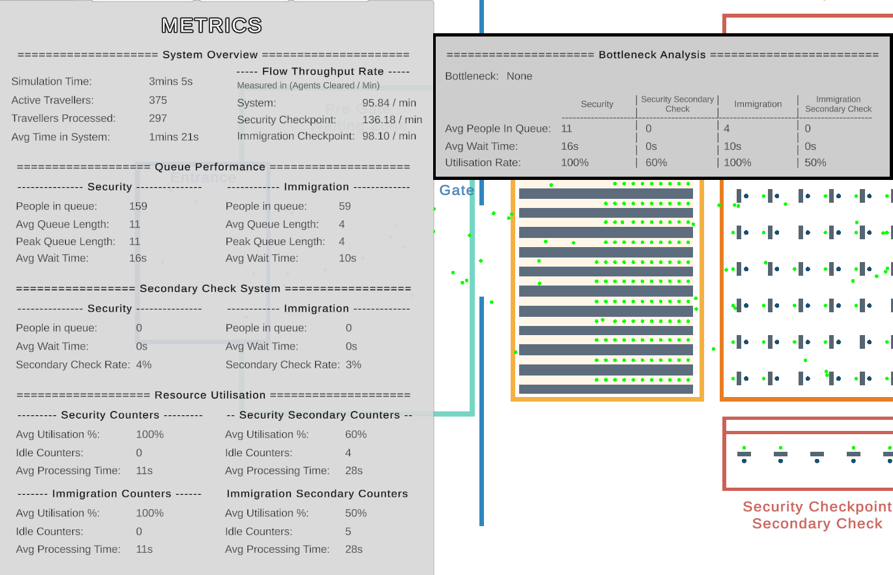
Baseline System Performance
System remains stable under moderate demand
Security is the primary bottleneck in most configurations
Immigration generally secondary unless staffing is reduced
Secondary inspections have low frequency but noticeable delay impact
Key observation:
System performance is primarily limited by Security processing capacity

Slide 4
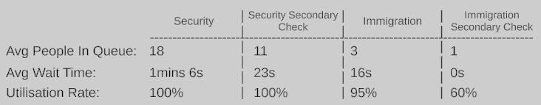
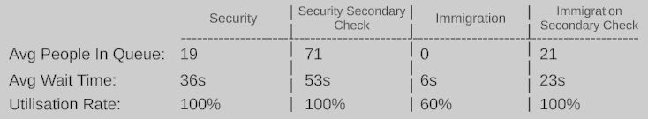
Scenario Comparison
Scenario: Default
Key findings:
Holiday scenario causes worst bottlenecks due to volume
High Risk increases delay due to secondary inspections
System does not self-stabilize once queues build
Scenario: Peak Holiday
Scenario: High Risk

Slide 5
Insights & Recommendations
Key bottlenecks:
Security = main constraint under most conditions
Secondary inspections amplify delays under High Risk
Holiday scenario exposes capacity limits quickly
Recommendations:
Prioritise increasing Security counter capacity
Add dynamic staffing during peak (Holiday-like) demand
Reduce secondary inspection impact during high congestion periods
Consider adaptive queue/counter scaling for stability
Increase secondary check counters during High-Risk periods
Key takeaway:
System performance is primarily constrained by Security capacity, with secondary inspections becoming a major stress amplifier under High-Risk conditions.

